Slide 1

Java course
-5-

Slide 2
3.Tomcat and servlets

Slide 3

What is a WebApp?
A web application (or webapp), unlike standalone application, runs over the Internet. Examples of webapps are google, amazon, ebay, facebook and twitter.

Slide 4
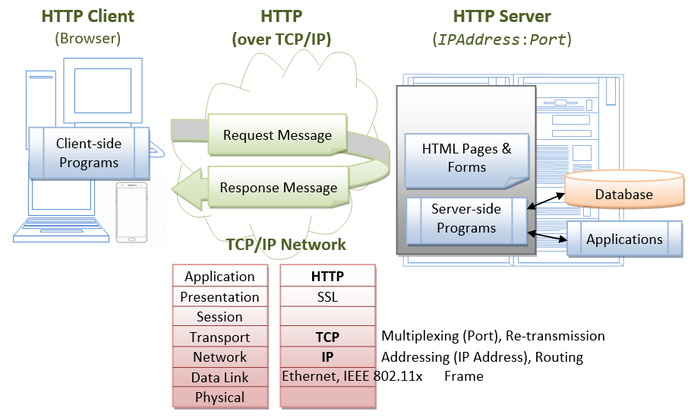
How a webapp works?

Slide 5
What are the components?
-HTTP Server: E.g., Apache HTTP Server, Apache Tomcat Server, Microsoft Internet Information Server (IIS), nginx, Google Web Server (GWS), and others.
-HTTP Client (or Web Browser): E.g., Internet Explorer (MSIE), FireFox, Chrome, Safari, and others.
-Database: E.g., Open-source MySQL, Apache Derby, mSQL, SQLite, PostgreSQL, OpenOffice's Base; Commercial Oracle, IBM DB2, SAP SyBase, MS SQL Server, MS Access; and others.
-Client-Side Programs: could be written in HTML Form, JavaScript, VBScript, Flash, and others.
-Server-Side Programs: could be written in Java Servlet/JSP, ASP, PHP, Perl, Python, CGI, and others.

Slide 6
DB Engine types
Relational
Relational databases are also called Relational Database Management Systems (RDBMS) or SQL databases. Historically, the most popular of these have been Microsoft SQL Server, Oracle Database, MySQL, and IBM DB2. The RDBMS’s are used mostly in large enterprise scenarios, with the exception of MySQL, which is also used to store data for Web applications.
Non-Relational
Non-relational databases are also called NoSQL databases. NoSQL has become an industry standard term, but the name is beginning to lose popularity since it doesn’t fully cover the complexity and range of non-relational data stores that are available.

Slide 7
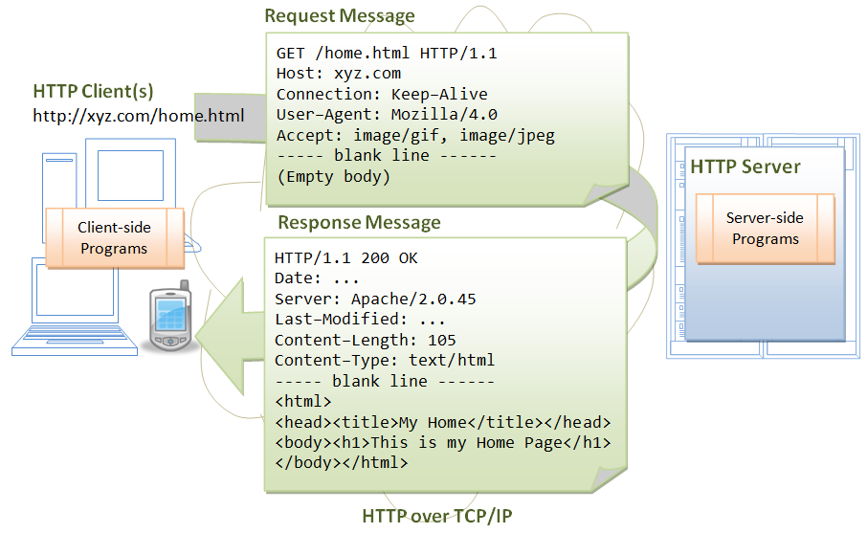
What is HTTP
HTTP is an application layer protocol runs over TCP/IP. The IP provides support for routing and addressing (via an unique IP address for machines on the Internet); while TCP supports multiplexing via 64K ports from port number 0 to 65535. The default port number assigned to HTTP is TCP port 80.
HTTP is an asynchronous request-response application-layer protocol. A client sends a request message to the server. The server then returns a response message to the client. In other words, HTTP is a pull protocol, a client pulls a page from the server (instead of server pushes pages to the clients).

Slide 8
What is Apache Tomcat
Apache Tomcat is a Java-capable HTTP server, which could execute special Java programs known as "Java Servlet" and "Java Server Pages (JSP)". Tomcat is an open-source project, under the "Apache Software Foundation" (which also provides the most use, open-source, industrial-strength Apache HTTP Server). The mother site for Tomcat is http://tomcat.apache.org. Alternatively, you can find tomcat via the Apache mother site @ http://www.apache.org.

Slide 9
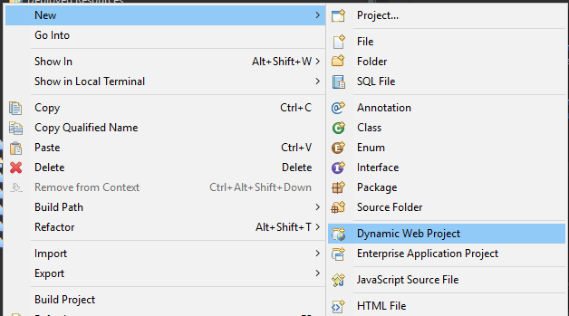
Creating a WebApp
Step 1: New->Dynamic Web Project

Slide 10
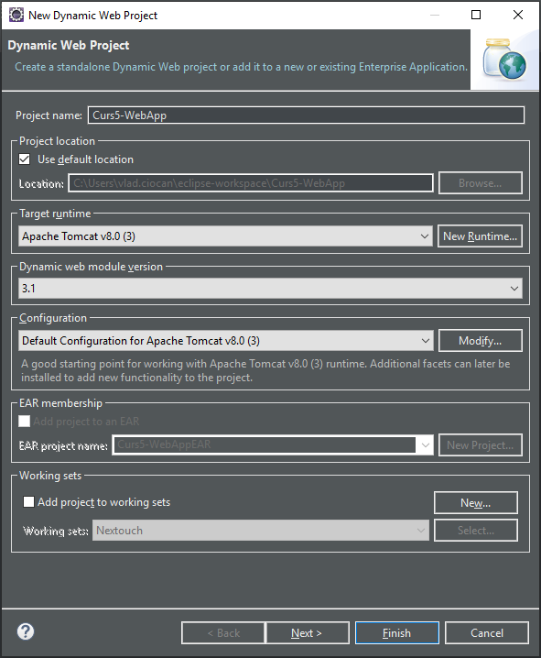
Creating a WebApp
Step 2: Fill form

Slide 11
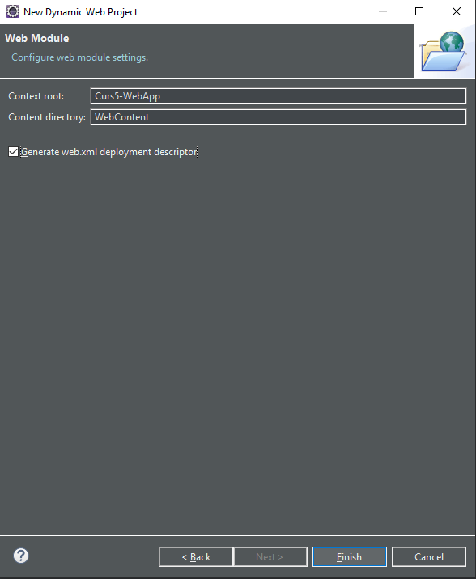
Creating a WebApp
Step 3: Check to generate web.xml

Slide 12
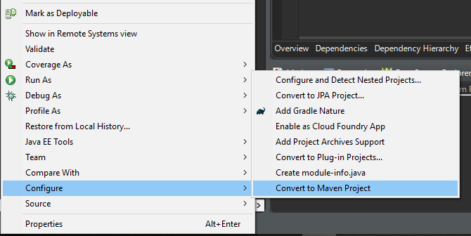
Creating a WebApp
Step 4: Convert to Maven Project

Slide 13
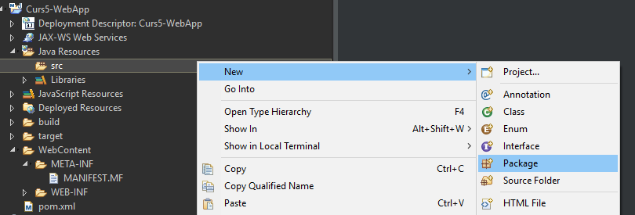
Creating a WebApp
Step 5: Add main Package
<servletContainer>

Slide 14
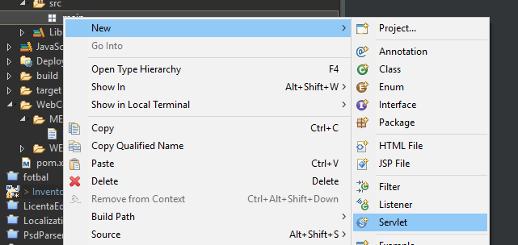
Creating a WebApp
Step 5: Add a servlet

Slide 15
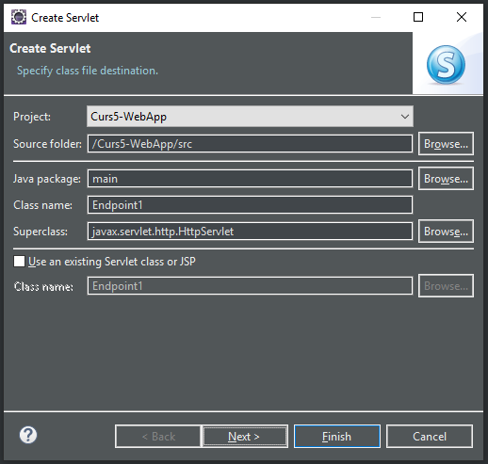
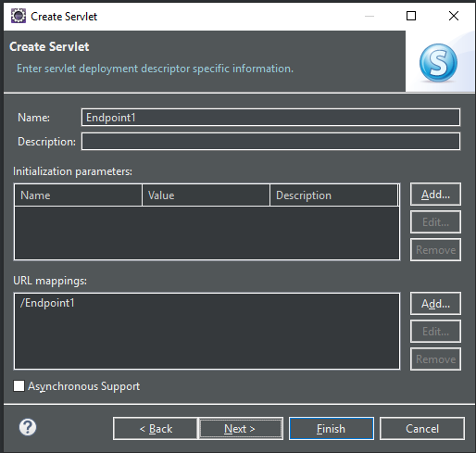
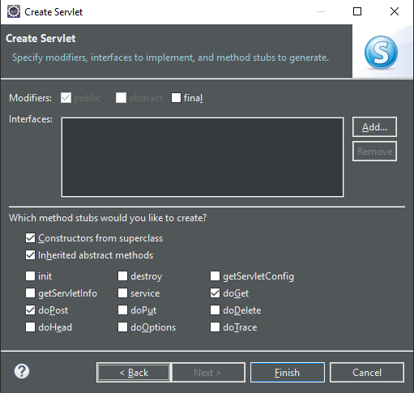
Creating a WebApp
Step 6: Configure servlet

Slide 16
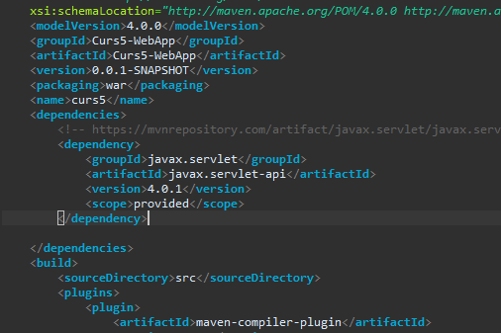
Creating a WebApp
Step 6: Add maven dependencies

Slide 17
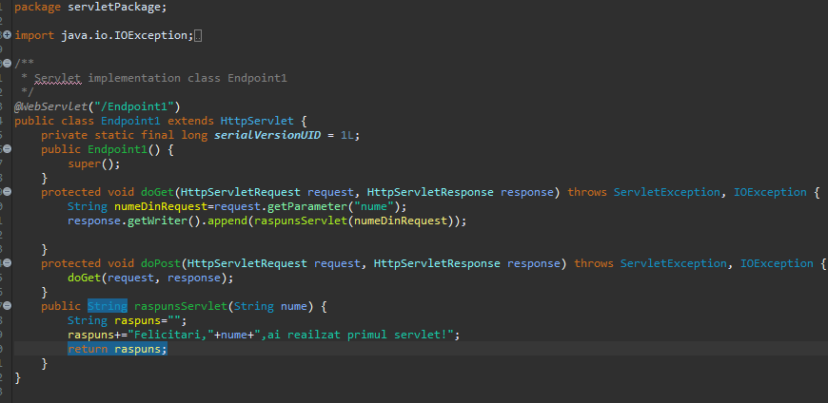
Creating a WebApp
Step 7: Add logic

Slide 18
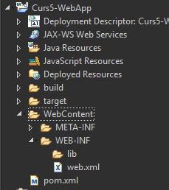
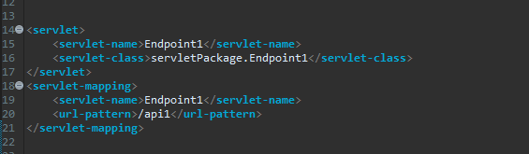
Creating a WebApp
Step 7: Map servlet in web.xml

Slide 19
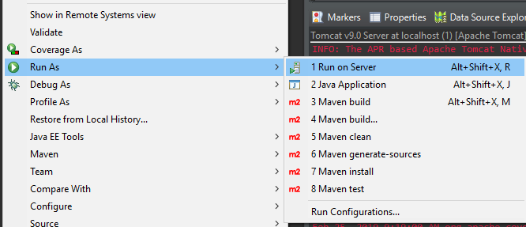
Creating a WebApp
Step 8: Save and run on server

Slide 20
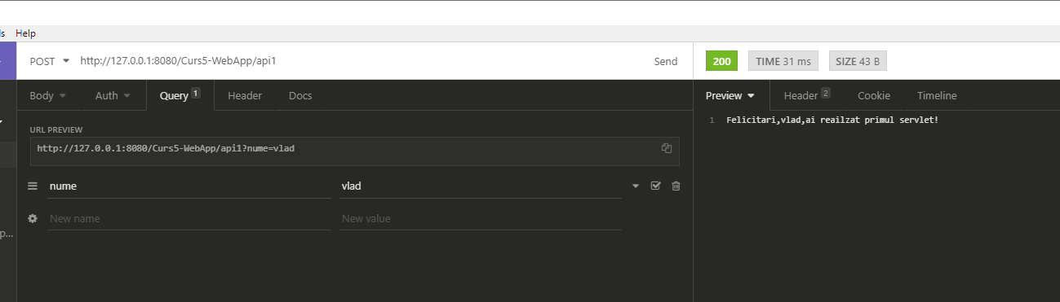
Test it

Slide 21
That`s it for today
Session review
-You learned servlets
-You learned about tomcat
-You know how API`s work
-You created you`re first endpoint
GOOD JOB! ☺

